Slide 1





ACCELERATING SOFTWARE DELIVERY
Why your team is slowing down
9-10 November, Łódź
Ewald Verhoeven
Strategic Partner
Platinum Sponsor

Slide 2

Single sprint(s)
to work on bugs/tech-debt

Slide 3
Backlog items
>= 12 months

Slide 4
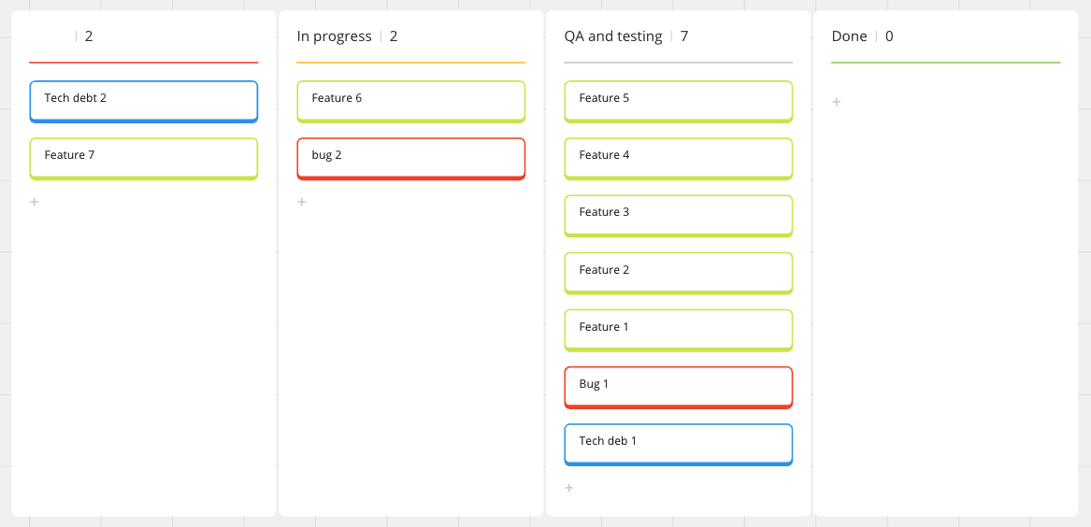

Slide 5
20%+ bugs
(by end of sprint)

Slide 6
Cancel retros to finish 'almost done' items

Slide 7
PO's who do testing

Slide 8



Slide 9
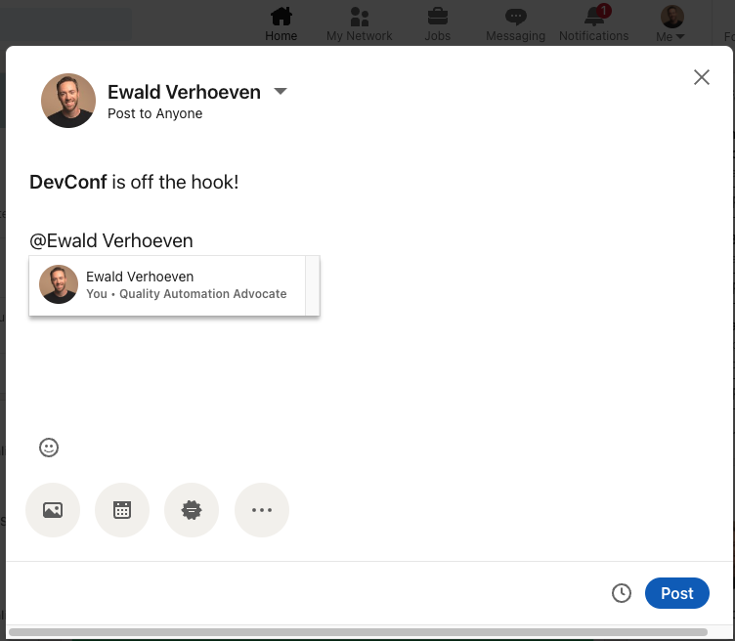


Giveaway!
1 hours of FREE consultancy
1-on-1 training
Team workshop
sparring session
Take a picture
Add it to a new post on linkedIn
Tag @Ewald Verhoeven
(code) reviews
conference talk

Slide 10


A previously delivered (working) 'thingy'

Slide 11



Legacy

Slide 12
Technical debt quadrant
Reckless
Prudent
We don't have time for that
We'll deal with it later
Deliberate
We don't know how
We shouldn't have done that
Accidental

Slide 13








Slide 14
Total savings: €2400,-
monthly savings €200,-
Total Cost for trip: €6000,-
Short: €3600,-

Slide 15
Total debt: €3600,-
(To be paid back in 1 year)
Savings (1 year) €2400,-
Short: €1200,-

Slide 16
What's the plan?...

Slide 17

Add more recourses

Slide 18
Add more recourses

Slide 19
Add more recourses

Slide 20

Calculate and (don't) accept

Slide 21
Turn off failing test
Low(er) test coverage
Bug reported
Hot fix (quickly!)
Forgot to update test
Build passes

Slide 22
DevOps teams are better (in handling tech debt)

Slide 23


Slide 24
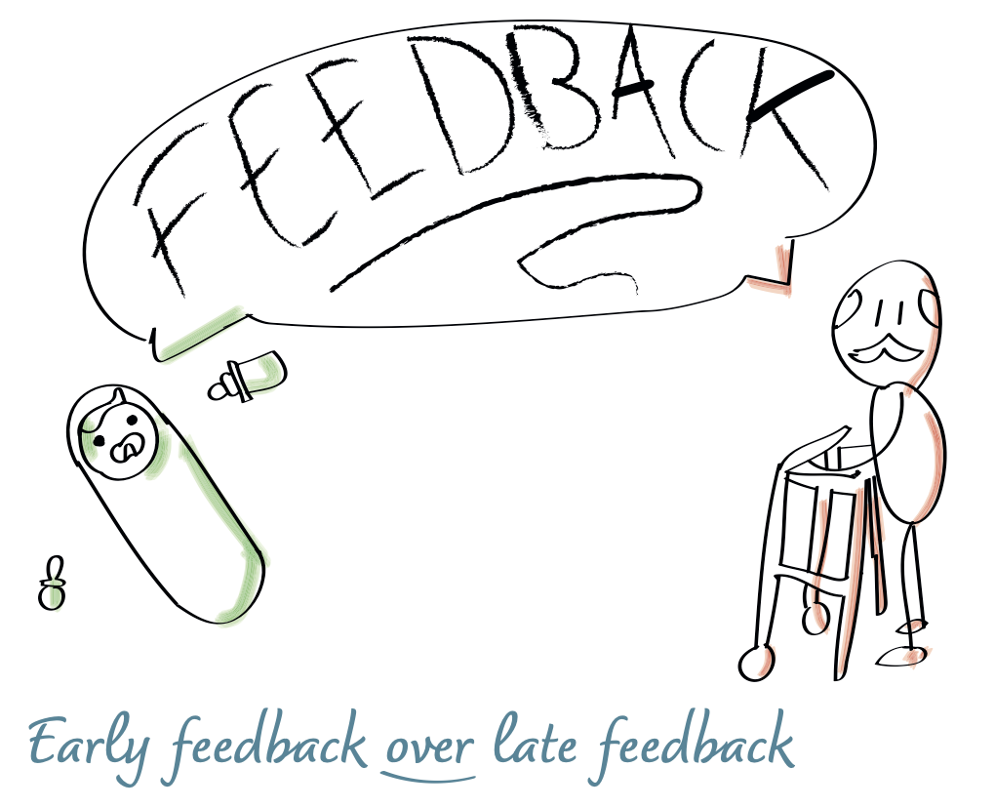

Slide 25
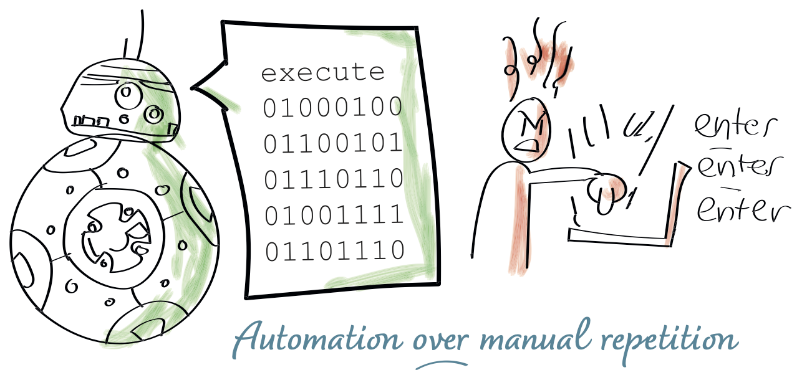

Slide 26

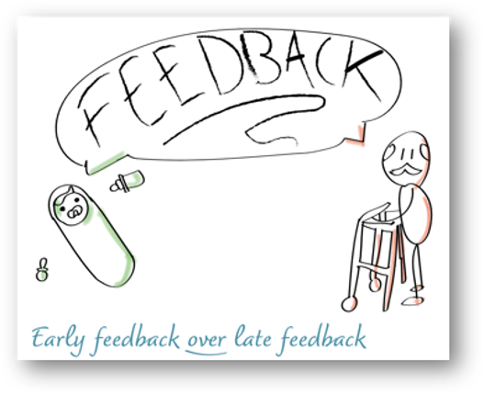

Slide 27
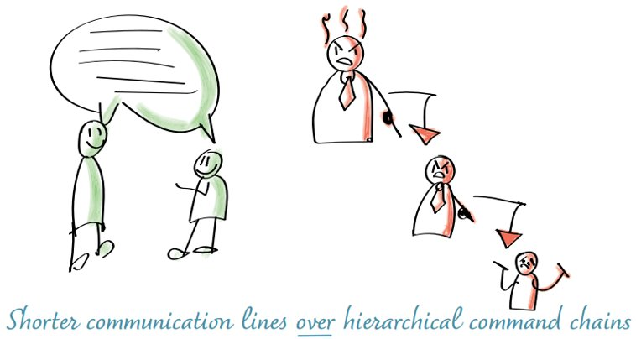

Slide 28
DoD
(the bank)

Slide 29


Slide 30
"Everything not (yet) given to an end-user, remains an untested hypothesis"

Slide 31

Flow

Slide 32
Decisions

Slide 33


Slide 34
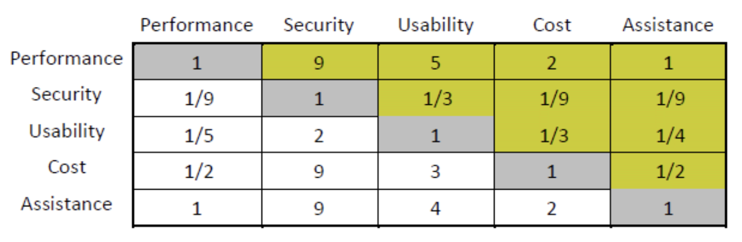
AHP

Slide 35
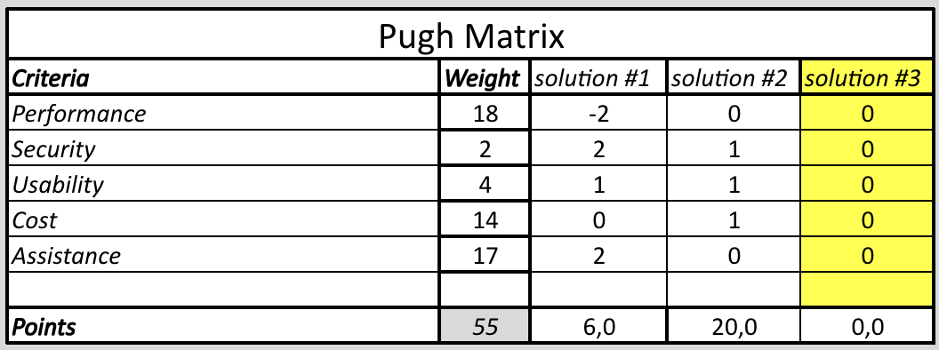
Pugh

Slide 36


Slide 37
"Good is good enough"

Slide 38


Slide 39


Slide 40
"Stop analysing old data!"

Slide 41
"No debt withouth a plan!"
"TD == top of the backlog"
"Start automating DoD stuff"
"Make data-driven decisions"

Slide 42
?

Slide 43


https://github.com/EwaldVerhoeven/DevConfPL
ewald@testcoders.nl

